Slide 1
STEM Certification

Slide 3
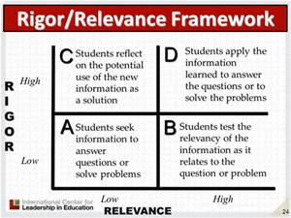

Slide 4
Compare and contrast 2 months and choose your favorite based on the comparison
Which months and associated seasons are most important for the environment. List them in priority order and justify your choices.
List the months of the year in order.
Draw a picture of what holidays fall in each month of the year.

Slide 5
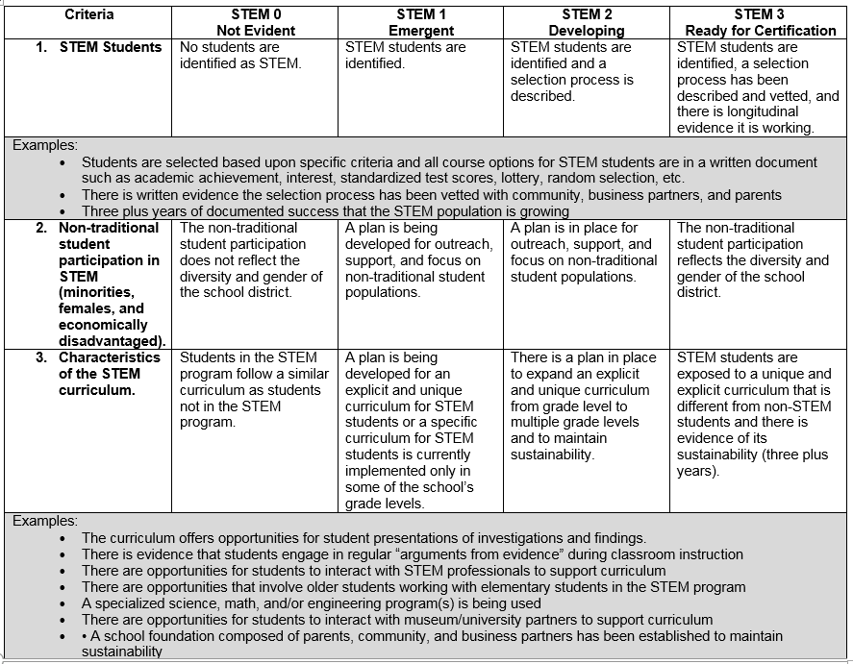

Slide 6
Reflect as a group
What are our areas of strength?
What are our areas of growth?

