Slide 1
Using the Rigor and Relevance Tool to Improve Instruction
PRIDE Meeting
October 20, 2015

Slide 2
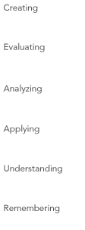
Notes:
Terry or Timi –
The CLC is focusing on the Rigor and Relevance tool to improve instruction. It is not something new, it is just something to think about while planning. When planning, it is important to plan not only WHAT the students are doing/learning, but IF the instruction/learning activities are rigorous and relevant to the students.

Slide 3
Notes:
Terry
Is the work thoughtful?
Are students engaged in answering high level questions?
Are students engaged in academic discussions?

Slide 4
Notes:
Osmerg

Slide 5
What does RIGOR mean to you?
Notes:
With grade levels, define what that means to you in your own words.

Slide 6
Notes:
Sapp
At this point, they will discuss with grade level to define what the specific level of rigor is in your group. While each individual group reports, the other groups will record.

Slide 7
Notes:
What does rigor look like for us?

Slide 8
Group Work
Kindergarten – Creating
First – Evaluating
Second – Analyzing
Third – Applying
Fourth – Understanding
Fifth - Remembering

Slide 9
Notes:
Is the work meaningful? Are the resources being used authentic? Can students make learning connections?
Osmerg

Slide 10
Notes:
Tara

Slide 11
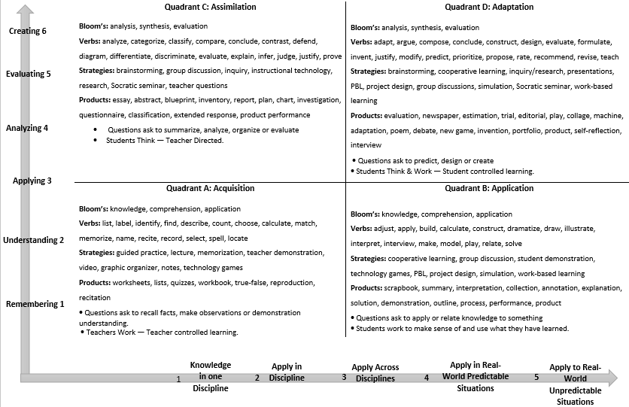
Notes:
Where do these lessons lie?
What makes these lessons quadrant C and D?
What are the students doing? Teachers doing?
Can we bump it up? How?
Osmerg
What would be some possible next steps/feedback for these teachers?

Slide 13
Video Observations
Video https://www.teachingchannel.org/videos/mingle-count-a-game-of-number-sense

