Slide 2
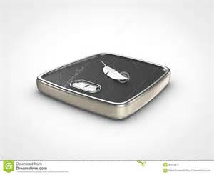
Which of these is the BEST estimate for the mass of a feather? A. 1 gram B. 100 grams C. 1 kilogram D. 10 kilograms
DOK Level 1: This item is a DOK level 1 item because it asks students to use what they know about units of mass and make an estimate.

Slide 3
Part A: Solve. 60 × 7 = Part B: Explain each step you used to solve the problem. _____________________________________________________________________________________________
Example of Correct Answer: The answer is 420. Another way to look at this is as repeated addition using multiples of ten. Seven groups of 6 tens is the same as 60 + 60 + 60 + 60 + 60 + 60 + 60, or 420. OR, this is the same as 6 × 7 × 10, which is 42 × 10 or 420.
DOK Level 2: This is a DOK level 2 item because it assesses the ability to solve a multiplication problem and explain the strategy used for solving it.

Slide 4
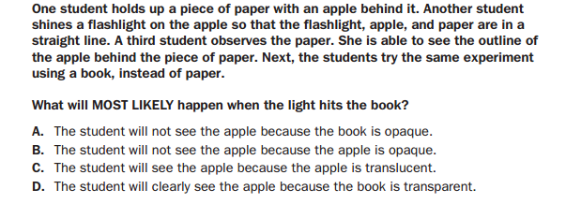

Slide 5
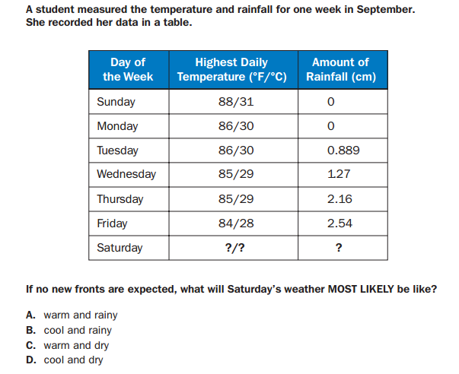

Slide 6
http://www.gadoe.org/Curriculum-Instruction-and-Assessment/Assessment/Pages/EOG-Study-Resource-Guides.aspx
Click me for more resources and links!

